Slide 1
Descriptive Statistical Measures
Notes:
A population is the collection of all items of interest to our study and is usually denoted with an uppercase N.
The numbers we've obtained when using a population are called parameters.
A sample is a subset of the population and is denoted with a lowercase n. And the numbers we've obtained when working with a sample
are called statistics.

Slide 2
Measures of Location
It provides estimates of a single value that in some fashion represents the centering of a set of data.
The most common is average
Measure students accomplishment in college: grade point average
Measure the performance of sports team: batting average
Measure performance in business: average delivery time
Arithmetic Mean, Median, Mode and Midrange

Slide 3
Arithmetic Mean
The average is formally called the arithmetic mean or simply the mean.
It is the sum of observations divided by the number of observations.
The mean is calculated in Excel using the function AVERAGE(data range)
– To find the mean cost per order in Purchase Orders Excel file
Mean is meaningful for both interval and ratio data. It can be affected by outliers.

Slide 4
Median
It specifies the middle value when the data are arranged from least to greatest.
For an
Odd number of observations, the median is the middle of the sorted numbers.
Even number of observations, the median is the mean of two middle numbers.
Two ways:
Using Sort option in Excel rank-order the data and then determine the median.
Excel function MEDIAN(data range)
To find the median cost per order in Purchase Orders Excel file
It is meaningful for ratio, interval and ordinal data.

Slide 5
Mode
It is the observation that occurs most frequently.
Most useful for data sets that contain a relatively small number of unique values.
Two ways
From frequency distribution and histogram, mode is the group with the greatest frequency
Using Excel function MODE.SNGL(data range). For data sets having multiple modes MODE.MUL(data range) is used.
Find the mode for A/P terms in Purchase Order Excel file.

Slide 6
Midrange
It is the average of the greatest and least value in the data set.
Two ways:
Sort the data and take average of first and last element
Use MIN and MAX Excel function to find minimum and maximum values respectively. Then take average of them.
average(min,max)
Usually a rougher estimate than the mean

Slide 7
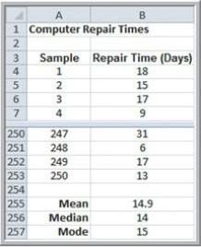
Quoting Computer Repair Time
Dataset includes 250 repair times for customers.
What repair time would be reasonable to quote to a new customer?
Mean, median and mode are all very close and show that the typical repair time is about 2 weeks.
What if repair time of 2 weeks is quoted?

Slide 8
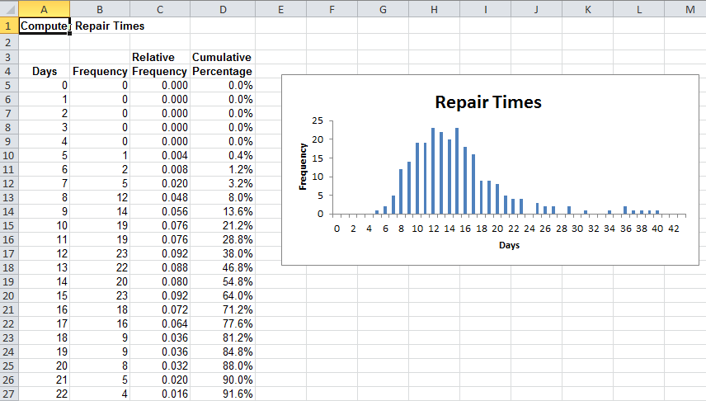
Quoting Computer Repair Time
Longest repair time took almost 6 weeks. Can the company give guaranteed repair time of 6 weeks?
90% of time repairs are completed within 3 weeks. Rare occasion it take longer.
Decision: The customers could expect their computers back within 2 to 3 weeks
and inform them that it might take longer if a special part was needed.

Slide 9
Measures of Dispersion
Dispersion refers to the degree of variation in the data, that is, the numerical spread (or compactness) of the data.
Several statistical measures characterize dispersion:
Range
Variance
Interquartile Range
Standard deviation

Slide 10
Interquartile Range
Range: difference between the maximum value and the minimum value in the dataset.
– =MAX(data range) – MIN(data range)
Range for cost per order data in Purchase Orders database.
Interquartile Range (IQR): difference between the first and third quartiles, Q3-Q1
Middle 50% of data
for cost per order data in Purchase Orders database.

Slide 11
Variance
Its computation depends on all the data. The larger the variance, the more the data are spread out from the mean and the more variability one can expect in the observations.
Excel function VAR.S(data range) for sample variance
Excel function VAR.P(data range) for population variance
The dimension of the variance is the square of the dimension of the observations. Hence difficult to use in practical applications.

Slide 12
Standard Deviation
It is the square root of the variance. Its unit of measure are the same as the units of data.
– Excel function STDEV.P(data range) calculates the standard deviation for a population
– Excel function STDEV.S(data range) calculates the standard deviation for a sample
It is a popular measure of risk particularly in financial analysis.
A larger standard deviation implies that while a greater potential of higher return exists, there is also greater risk of realizing a lower return.
– Find mean and standard deviation for Intel and GE stocks in Closing Stock Prices Excel file.

Slide 13
Coefficient of Variation
It provides a relative measure of the dispersion in data relative to the mean and is defined as
CV = standard deviation
mean
Multiplied by 100 to express it as percent.
For comparing the variability of two or more datasets.
It provides a relative measure of risk to return. The smaller the coefficient of variation, the smaller the relative risk is for the return provided.
Apply to Closing Stock Prices worksheet.

Slide 14
Grouped Data
The sample data are summarized in a frequency distribution.
Extracting information from government databases such as the Census Bureau of Labor Statistics
The mean and variance are calculated differently. Calculations of Mean and Variance Using a Frequency Distribution in Computer Repair Time Excel file.

Slide 15
Measures of Association
Two variables have a strong statistical relationship with one another if they appear to move together.
– Ice cream sales likely have a strong relationship with daily temperature.
Scatter plot is used to visualize relationships between two variables.
Covariance and Correlations

Slide 16
Covariance
It is a measure of the linear association between two variables, X and Y.
It is the average of the product of the deviations of each pair of observations from their respective means.
The sign of the covariance tells whether there is a direct relationship or an inverse relationship.
The Excel function COVARIANCE.P(array1,array2) and COVARIANCE.S(array1,array2) computes the covariance of a population and sample respectively.
– Using Colleges and Universities Excel file

Slide 17
Correlation
It is a measure of the linear relationship between two variables, X and Y, which does not depend on the unit of measurements.
It is measured by correlation coefficient.
Excel CORREL(array1, array2) function computes the sample correlation coefficient of two data arrays.
Correlation of
0 indicates that the two variables have no linear relationship to each other.
– +ve
-ve

Slide 18
Excel Correlation Tool
It computes correlation coefficients for more than two arrays.
Select Correlation from the Data Analysis tool list.
Using Correlation Tool for Colleges and Universities Data

